Slide 1
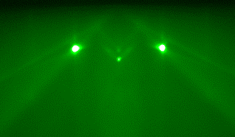
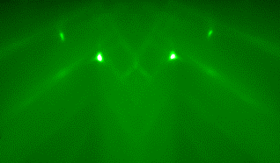
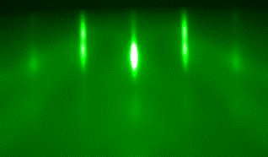
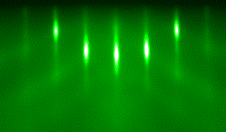
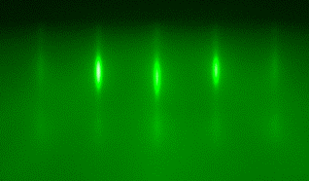
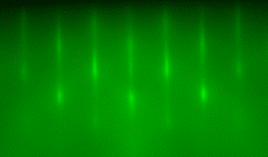
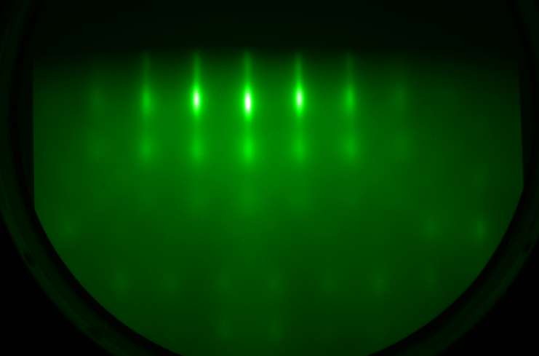
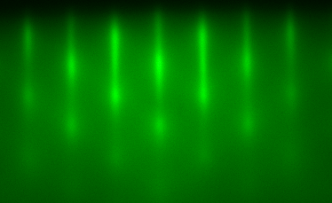
Figure 1
(a)
(b)
(c)
YSZ [100]
(d)
YSZ [110]
(e)
EuO [100]
(f)
EuO [110]
(g)
La_{0.10}Eu_{0.90}O [100]
(h)
La_{0.10}Eu_{0.90}O [110]
La_{0.20}Eu_{0.80}O [100]
La_{0.20}Eu_{0.80}O [110]

Slide 2

Figure 2
(a)
(b)
Intensity (a. u.)
c-axis ($Å$)
(c)
2θ (degree)
(d)
x
Normalized magnetization
T_{C} (K)
T_{C}
Temperature (K)
x

Slide 3



Figure 3
(a)
$$ρ_{xy} (μΩ∙cm)$$
La_{0.10}Eu_{0.90}O
T = 70K
(b)
B (T)
$$ρ_{AH} (μΩ∙cm)$$
$M (μ_{B}/Eu$)
B (T)

Slide 4




Figure 4
(a)
$$ρ_{TH}$$
(b)
$$ρ_{TH}$$
La_{0.036}Eu_{0.964}O
La_{0.10}Eu_{0.90}O
B (T)
B (T)
SkX
SkX
(c)
Temperature (K)
$$ρ_{TH}$$
(d)
Temperature (K)
$$ρ_{TH}$$
La_{0.15}Eu_{0.85}O
La_{0.20}Eu_{0.80}O
B (T)
B (T)
SkX
SkX
Temperature (K)
Temperature (K)

Slide 5

Figure 5
$$ρ_{TH} (μΩ∙cm)$$
La_{0.10}Eu_{0.90}O
B (T)

Slide 6


Figure 6
(a)
Skyrmion radius (nm)
(b)
x
Skyrmion density ($m^{−2}$)
La concentration (10²¹${cm}^{−3}$)

